Slide 1
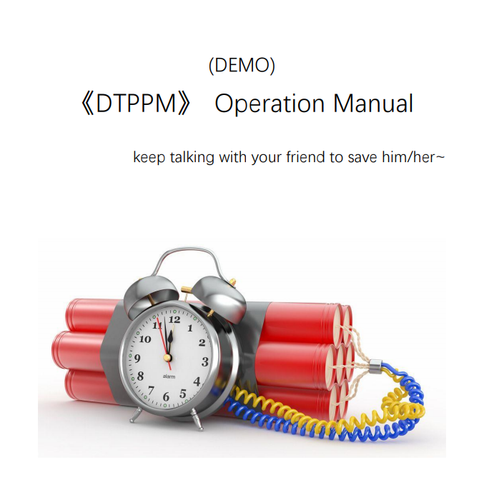
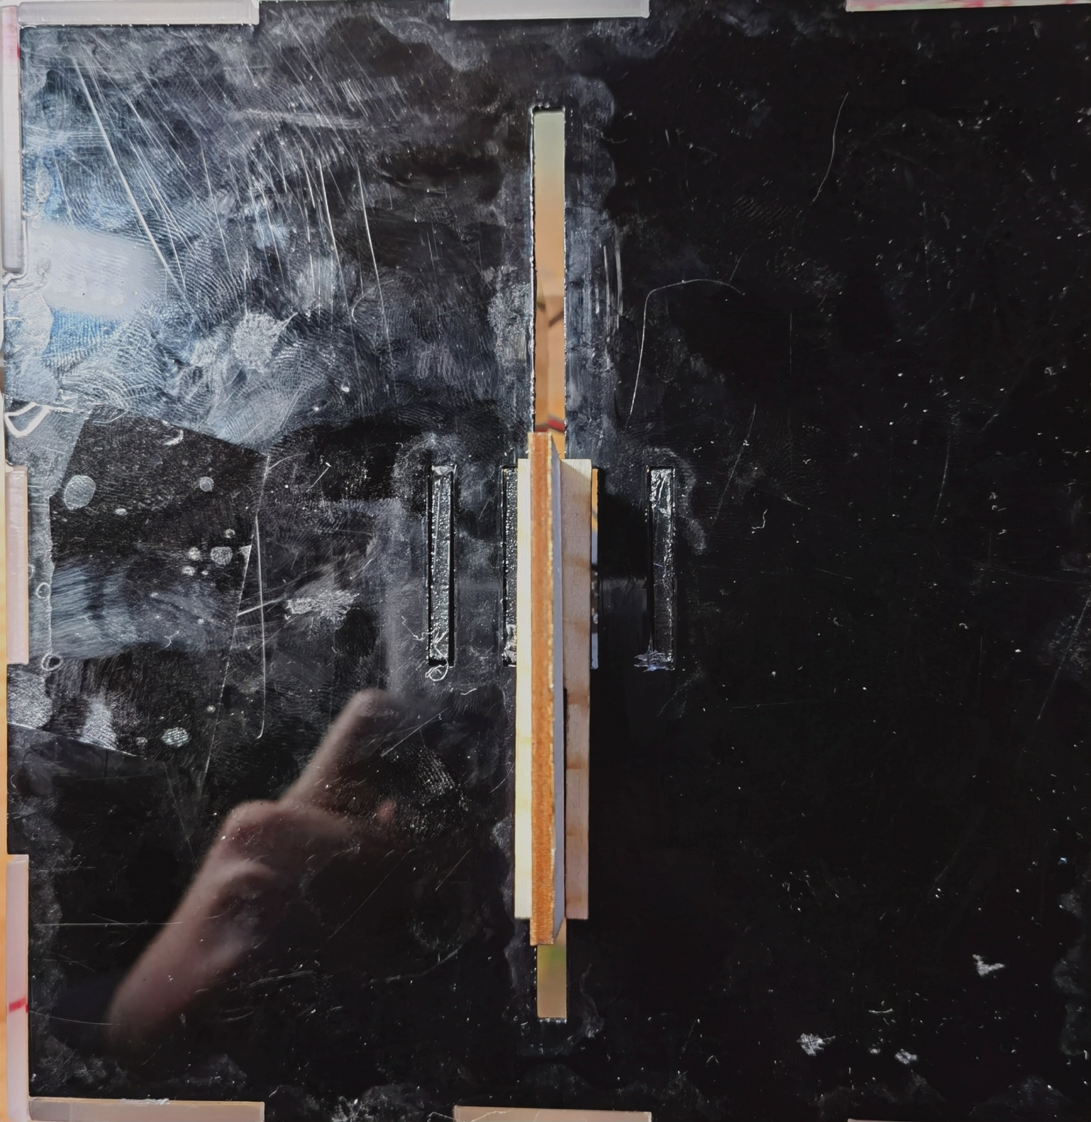
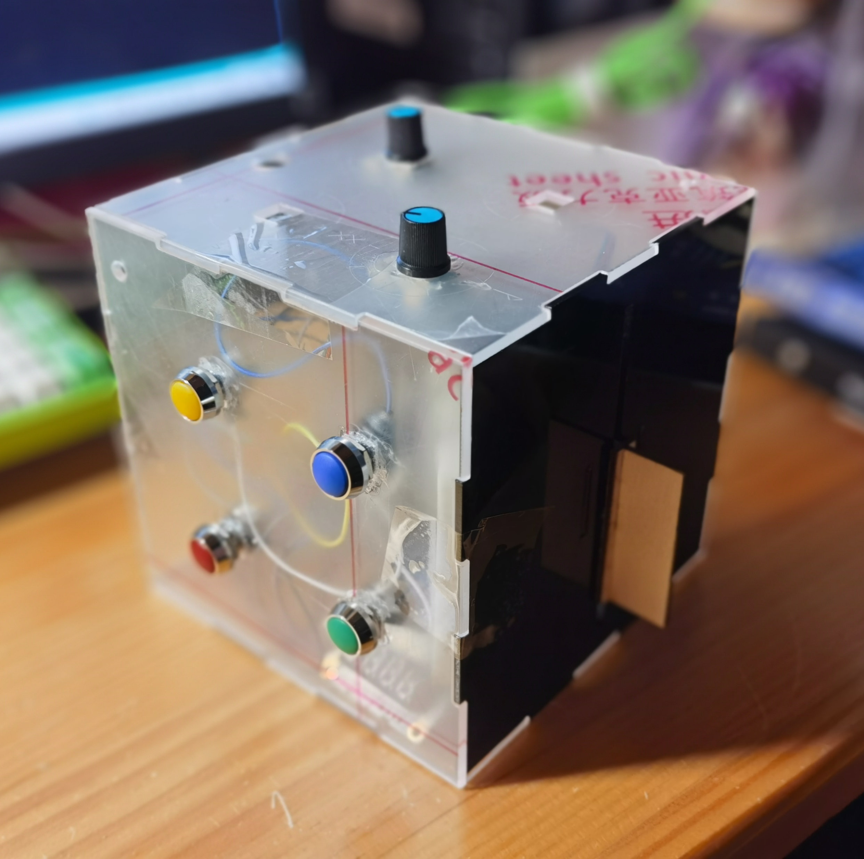
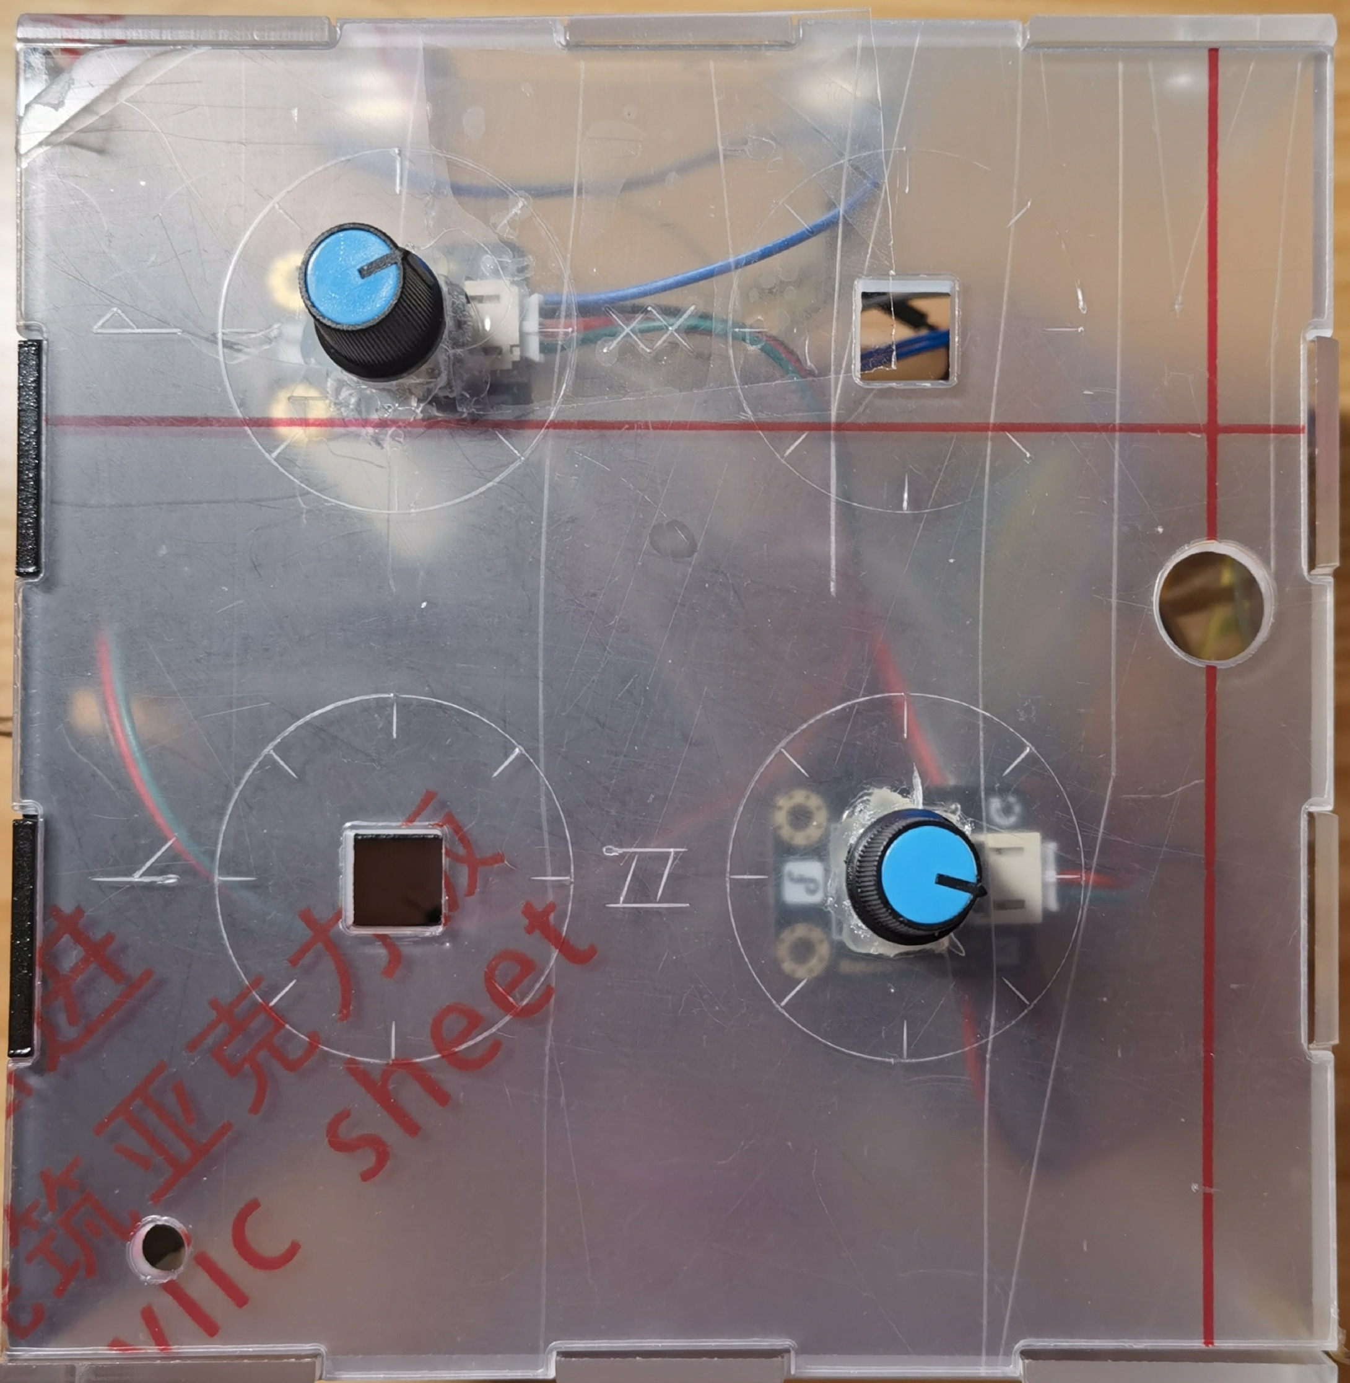
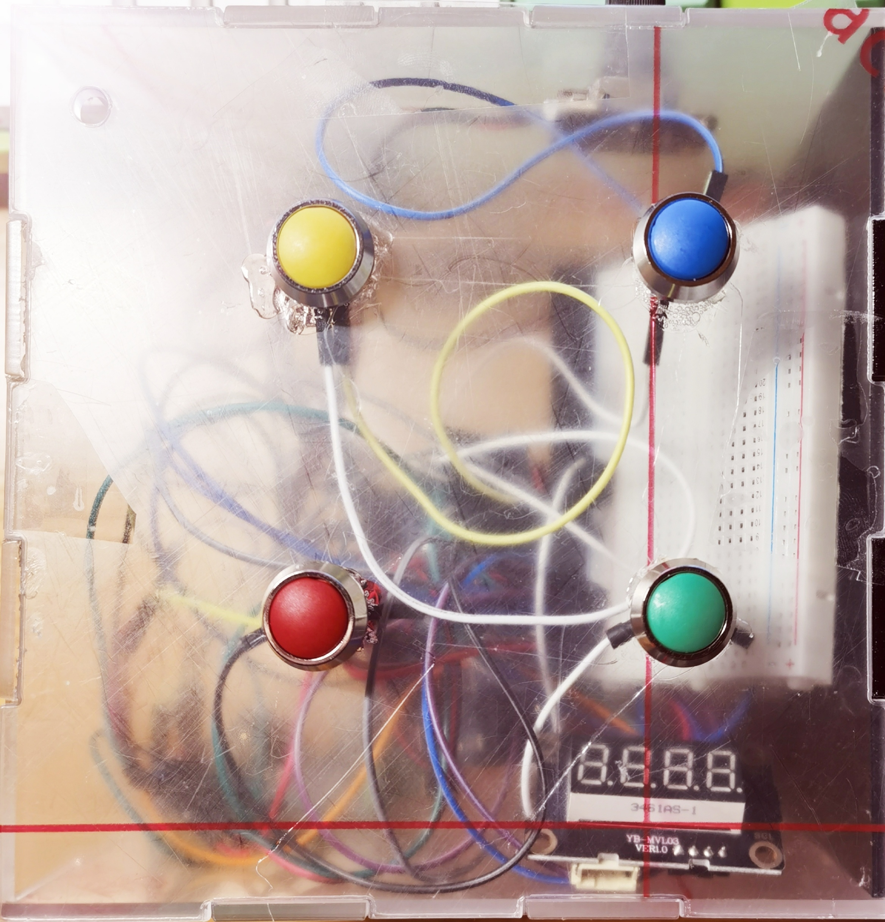
Problems during epidemic
Operation Manual
MOVE CARFULLY
Motion——boring
Communication
Electronic Device
YOUR PARTNER IS INVOLVED IN A BOMB CRISIS!
ONLY YOU HAVE THIS BOMB DISPOSAL MANUAL! DO THE
RIGHT THING AND... HAVE FUN~
If a slider can be seen on the bomb, this puzzle need to be solved.
HMW
HMW deal with boring and keep communication with less E.D.
BOMB
BOX
BEHIND THE RUNE
RAINBOW
SUCCESS OR DEATH
OUR SOLUTION
If some knobs can be seen on the bomb, this puzzle need to be solved.
If some buttons can be seen on the bomb, this puzzle need to be solved.
BOMB
BOX
POWERED BY DTPPM

